Slide 1
Healthcare and Income Disparity in the DMV
Ms Emily Reynolds
Mr. Richie Pherson
Mr. Mike Marshall
Mr. Vibhanshu Shekhar

Slide 2
Motivation & Summary Slide
We are interested in how economic conditions in specific geographic areas affect access to healthcare in the Washington, DC area.
Is there a relationship between economic indicators and the availability of health care in certain areas?
We found that there weren’t any strong relationships between income and the availability of healthcare providers
However, we did find that there were more hospitals in relatively lower- and higher-income areas
We found that insurance coverage rates were higher in areas with higher income per capita.

Slide 3
Questions & Data
Question #1: What is the likelihood that more doctors would be located in higher populated areas?
Number of doctors by zip code: Google Places API
Population by zip code: US Census Bureau, American Fact Finder
Question #2: Would hospital facilities be located more within higher income or lower income areas?
Number of hospitals by zip code: Google Places API
Income by zip code: US Census Bureau, American Fact Finder
Question #3: Is the unemployment rate higher in lower income areas?
Unemployment and Per Capita Income by zip code: US Census Bureau, American Fact Finder
Question 4: Does per capita income influence the percentage of individuals who possess healthcare insurance?
Per Capita Income and Percent of pop. Insured: US Census Bureau, American Fact Finder

Slide 4
Data Cleanup & Exploration
Exploration and Cleanup
Selected desired data and downloaded into multiple CSVs of demographic data sets from the U.S. Census Bureau.
Cleaned it in Pandas with DataFrames – eliminated, renamed, and merged DataFrame from multiple CSVs, and narrowed the scope of the dataset to target only zip codes within the D.C. Beltway.
Built a data set of Healthcare provider details from Google Place API.
Turned the aggregate Google Places data into a DataFrame, which was merged with the economic indicators
Challenges
Google nearby places API exhibits slightly different behaviors at different search resolutions due to location ranking. This necessitated performing reiterative queries to ensure an adequate level of geographic coverage, and ensure an appropriate sample of data was returned. Searches performed with larger overlapping radii tended to return far fewer unique results than in queries constructed with narrower search radii.
New Tools
GeoJSON
ipywidgets
HTML/CSS as string variables
Matplotlib Colormaps
AST, for a safer alternative for literal interpretation of GeoJSON data out of a dataframe object.

Slide 5
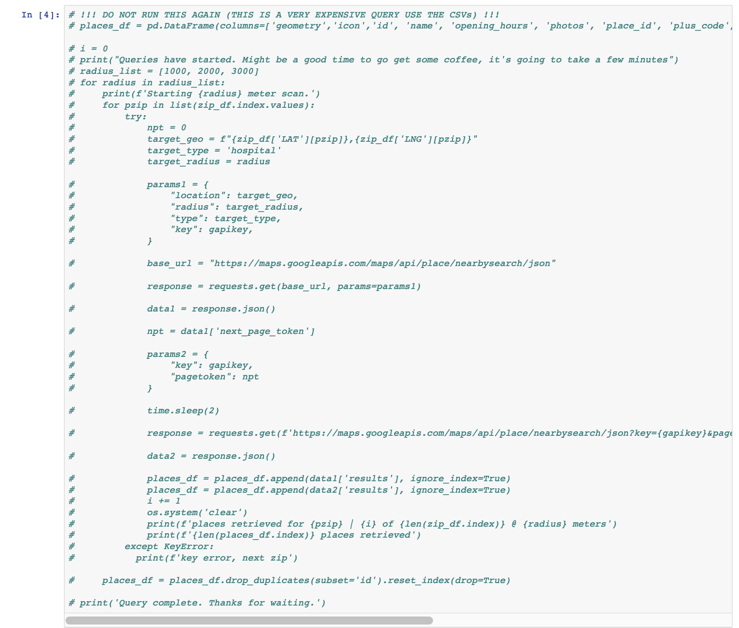
Building the Provider Locations List
We built a provider location dataset through an iterative Google nearby places query against the approximate geographic center-point of targeted metro area zip codes, first at 1km, then 2km, then 3km. Duplicate location ID’s were removed on each pass. Query resulted in several thousand unique location ID’s for healthcare providers and hospital facilities which were then associated with their respective zip codes and leveraged as data for this analysis.

Slide 6
Data Analysis & Visualizations
To analyze our data, we created visualizations that provided insights into the data.
Choropleth maps visualizing zip codes and their economic indicators overlaid with geographic locations of doctors and hospitals
Scatter plots showing patterns between variables

Slide 7
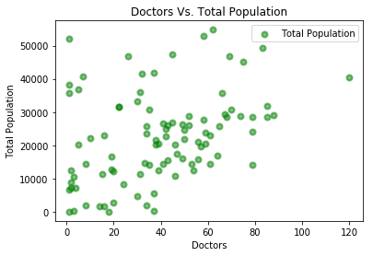
Question #1: What is the likelihood that more doctors would be located in higher populated areas?
We did not find a relationship between the income of a zip code and the number of doctors practicing there.

Slide 8
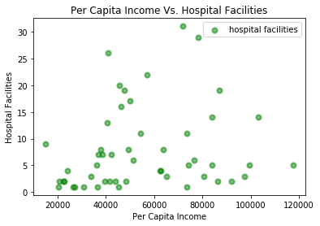
Question #2: Are there more hospitals in lower- or higher-income zip codes?
More hospitals at either the higher or lower end and not as much within areas with medium income per capita
Possibly due to lower property costs and specialization of facilities

Slide 9
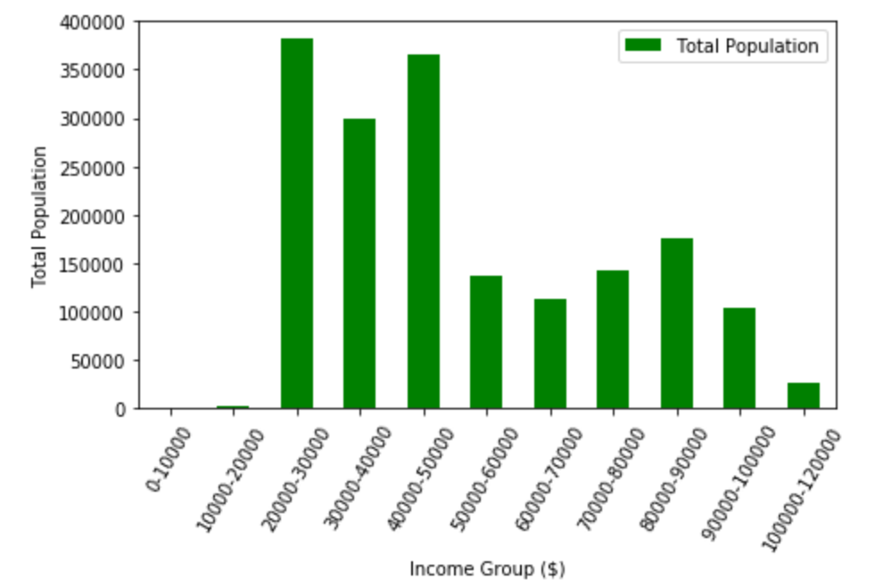
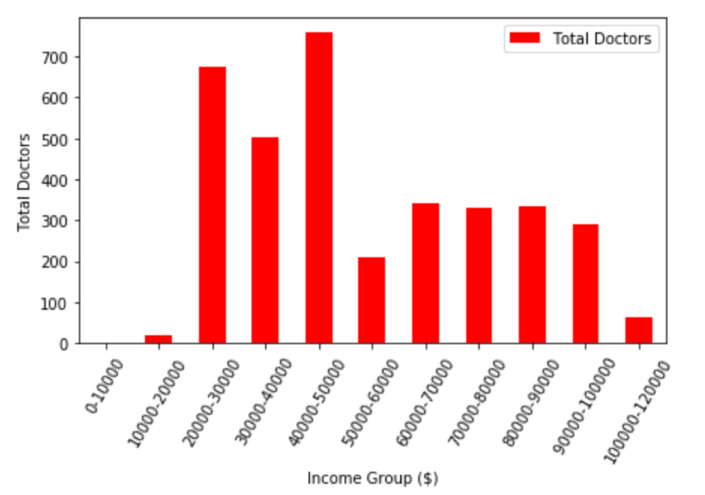
Income, Population & Doctors
Population by ZCTA Per-Capita Income
Provider Locations by ZCTA Per-Capita Income

Slide 10
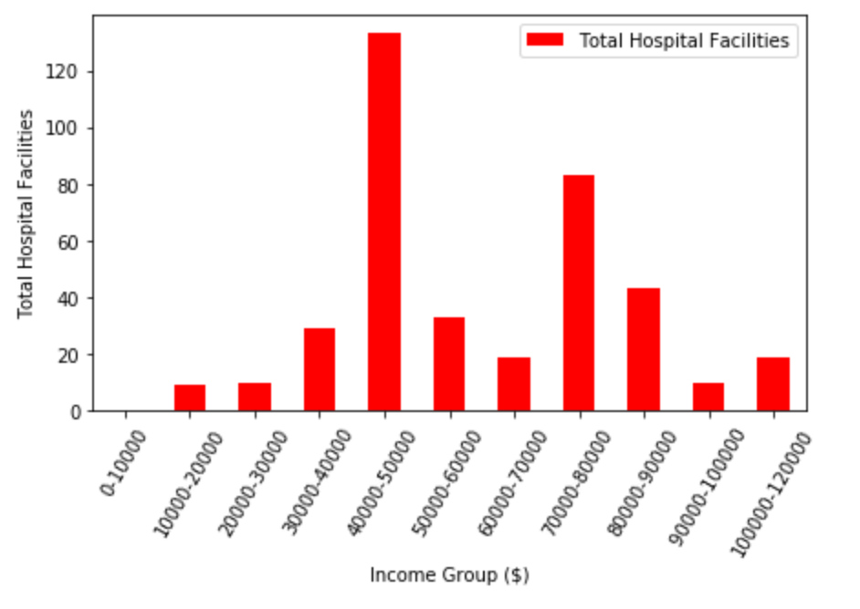
Income, Population & Hospital Facilities
Population by ZCTA Per-Capita Income
Hospital Facilities by ZCTA Per-Capita Income

Slide 11
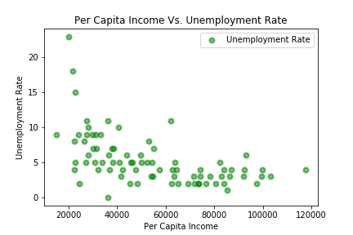
Question #3: Is the unemployment rate higher in lower income areas?
Unemployment is higher within lower income per capita areas.

Slide 12
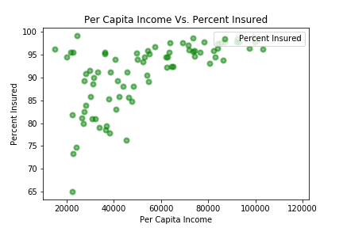
Question 4: Do areas with higher per capita income have higher individual coverage rates?
Individuals located in lower income areas are less likely to have healthcare coverage compared to those in higher income areas

Slide 13
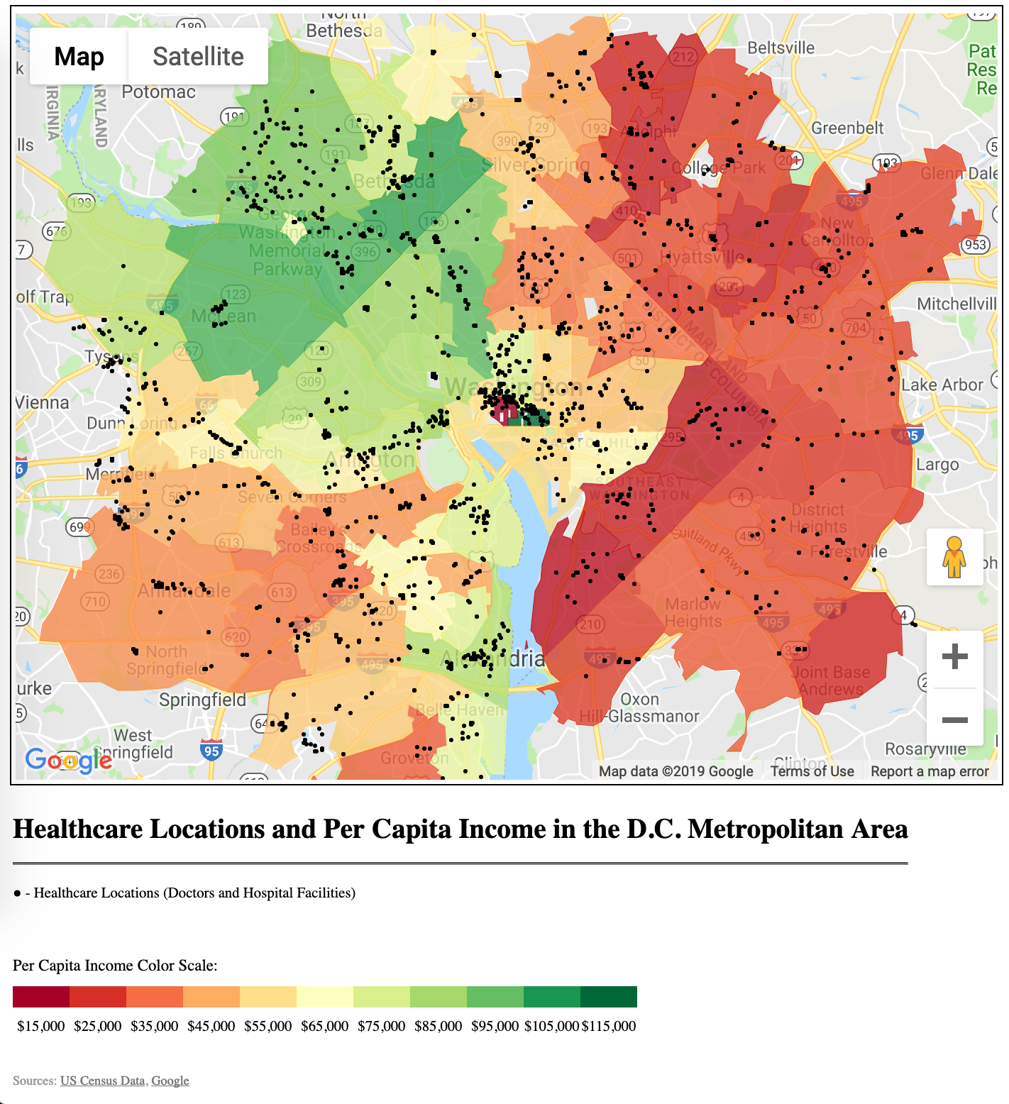
Mapping the data
Among datasets made available by the U.S. Census Bureau were collections of the various tabulation areas. By pairing the Census’ ‘ZIP Code Tabulation Area’ geographic boundaries data with demographic data organized by zip code, we were able to utilize the Google Maps API to render a choropleth map. Geographic coordinates of healthcare providers were retrieved through a Google Places API query. The returned coordinates are fed into the mapping API, allowing us to plot markers for the entire collection of healthcare facilities as an additional visualized layer.

Slide 14
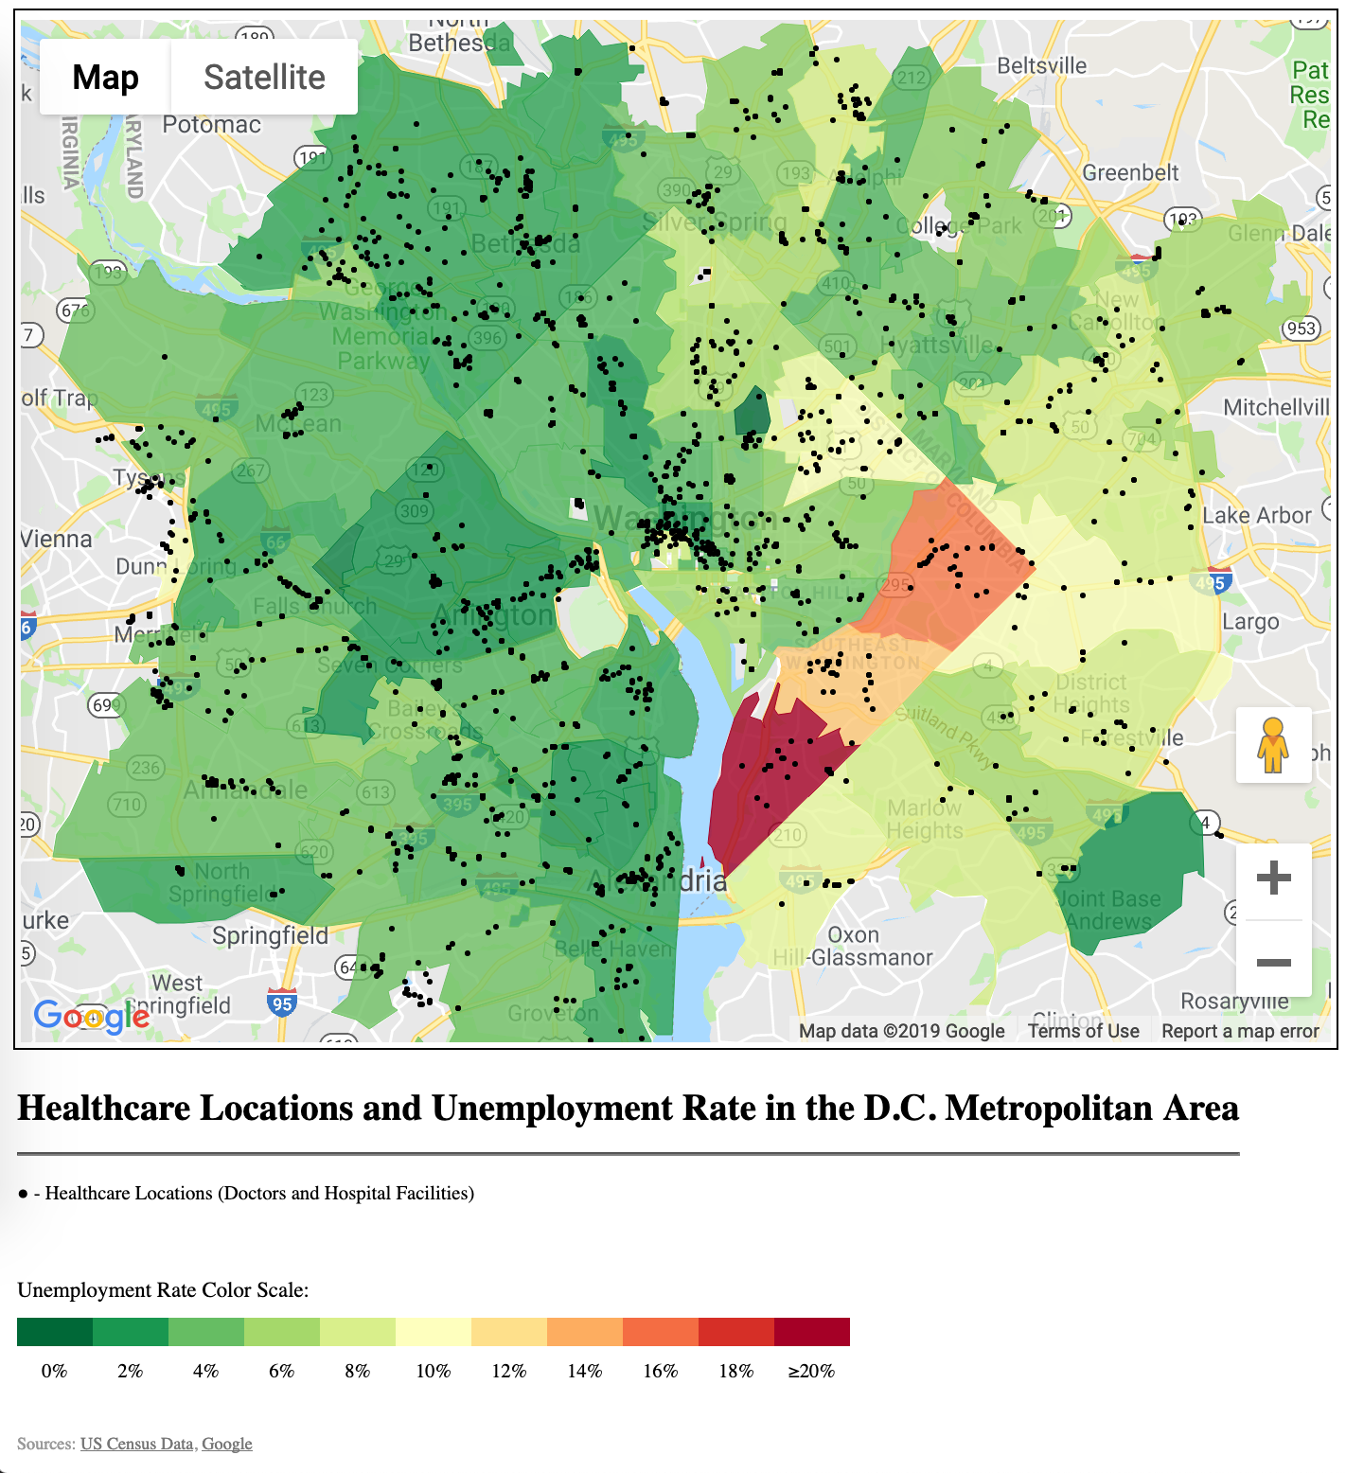
Mapping the data
Among datasets made available by the U.S. Census Bureau were collections of the various tabulation areas. By pairing the Census’ ‘ZIP Code Tabulation Area’ geographic boundaries data with demographic data organized by zip code, we were able to utilize the Google Maps API to render a choropleth map. Geographic coordinates of healthcare providers were retrieved through a Google Places API query. The returned coordinates are fed into the mapping API, allowing us to plot markers for the entire collection of healthcare facilities as an additional visualized layer.

Slide 15
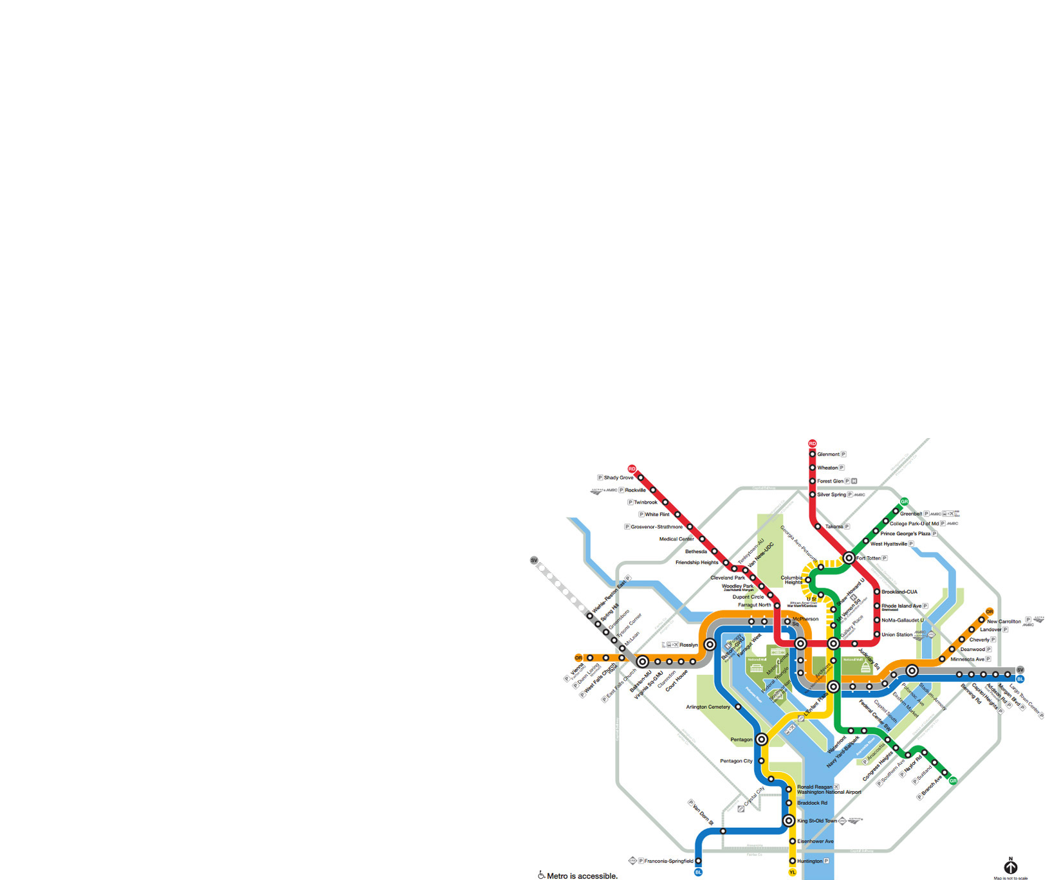
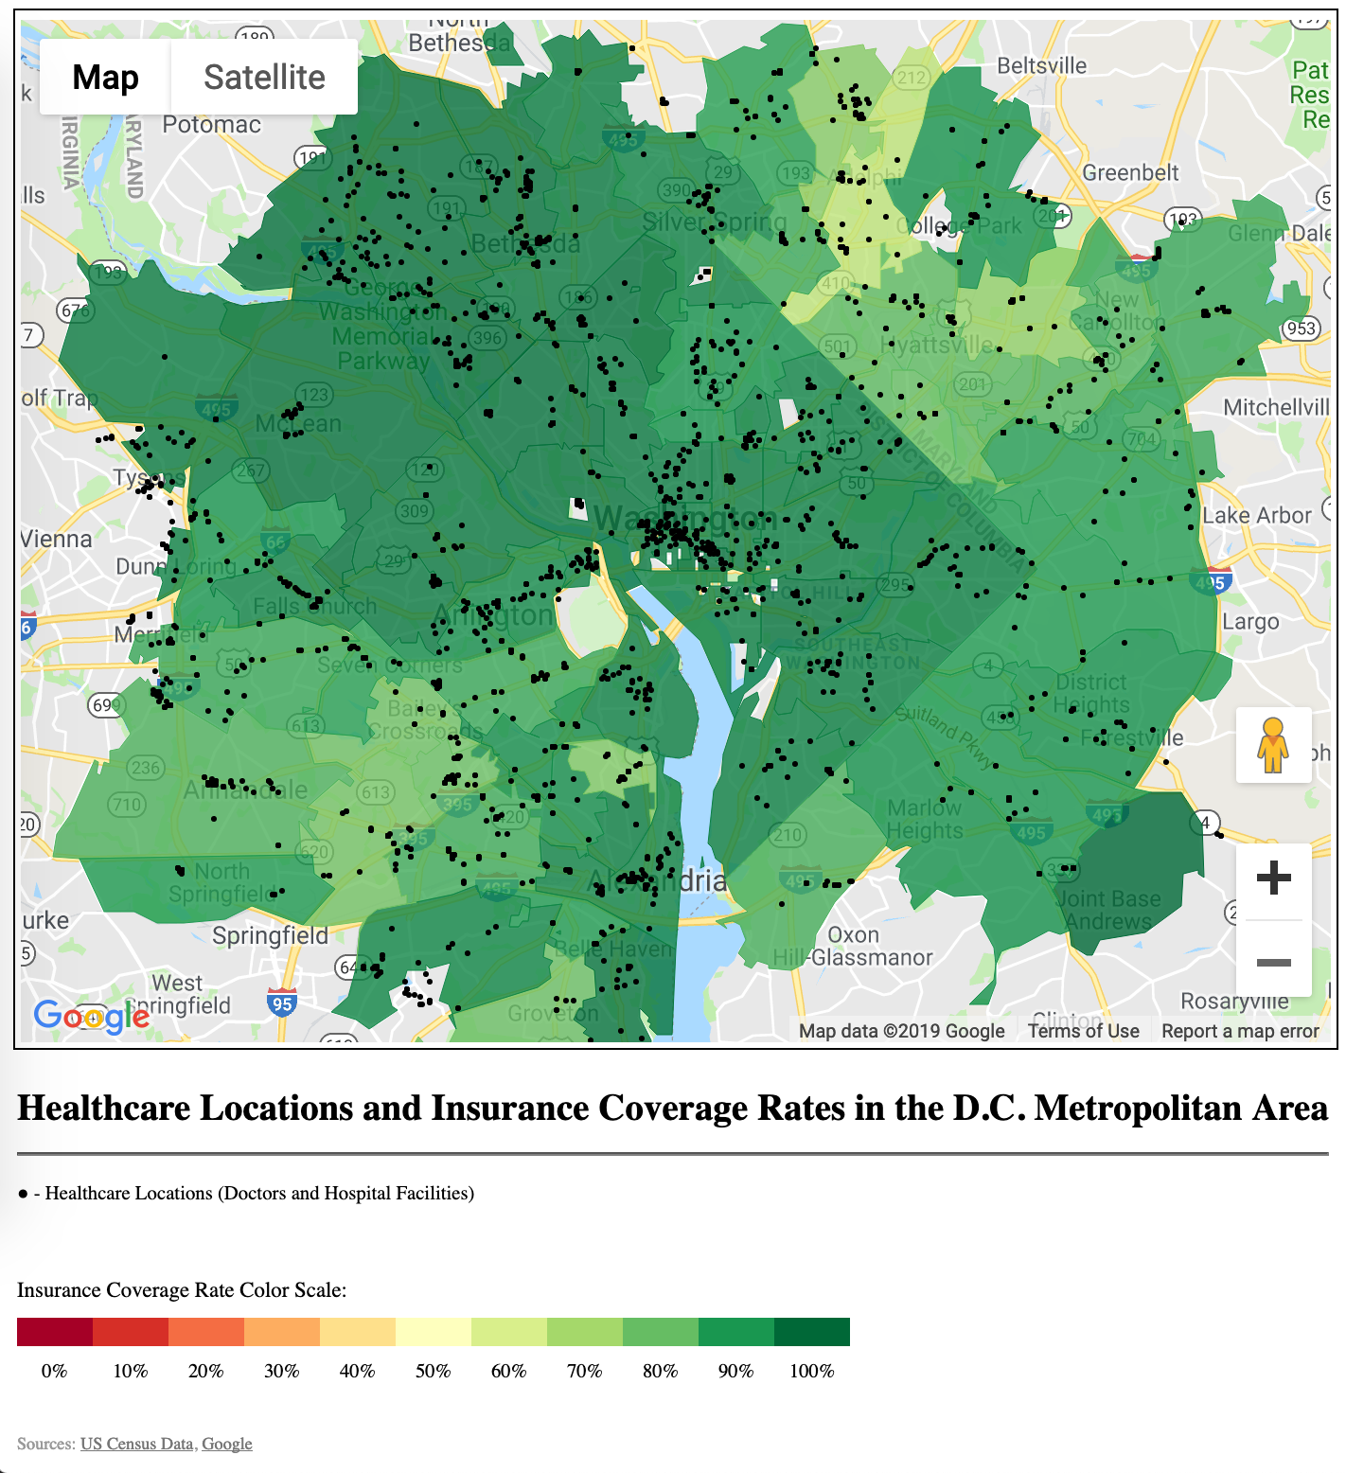
Mapping the data
Among datasets made available by the U.S. Census Bureau were collections of the various tabulation areas. By pairing the Census’ ‘ZIP Code Tabulation Area’ geographic boundaries data with demographic data organized by zip code, we were able to utilize the Google Maps API to render a choropleth map. Geographic coordinates of healthcare providers were retrieved through a Google Places API query. The returned coordinates are fed into the mapping API, allowing us to plot markers for the entire collection of healthcare facilities as an additional visualized layer.

Slide 16
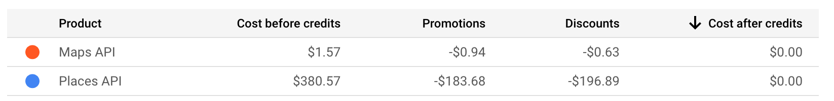
Unexpected Insights
Mapping the data provides an interesting perspective on the differences in city and urban planning between local municipalities. (e.g. Some jurisdictions show tightly clustered groups or corridors of providers along major thoroughfares, still others show a more scattered collection.
Running what turned out to be over ten thousand Google Places API calls turns out to be fairly costly. Luckily the API key being used did not ultimately reach the end of its promotional quota. The returned results were exported to CSV and called locally, and the API call program was retired afterwards. No credit cards were harmed in the making of this dataset.

Slide 17
Post Mortem
Further statistical analysis would be required to determine whether there are more robust trends.
With more time and resources, additional focus would have been spent on the validation of the data harvested from the Google Places API.
Additional research could be performed on other metropolitan areas, allowing comparison of the D.C. metro against cities of similar populations.
We would also get time-series data to find out whether there has been any trends over time.
New questions raised; do the economic conditions of an area have a measurable impact on the quality of healthcare facilities.

Slide 18
Questions
Thank you

